Slide 1


COVID-19 Analysis
Notes:
victoria

Slide 2

BIA 678 A - Big Data Technologies
Under the guidance of Dr. David Belanger
Notes:
victoria

Slide 3


Agenda
Introduction
Data Insights
Data Sample
Exploratory Data Analysis
Data Visualization
Model
Analysis on the Impact of Scale
Key Results
Conclusion
Future Recommendations
Notes:
victoria

Slide 4

Introduction
In 2020, the novel COVID-19 virus has turned into a global pandemic and has affected nearly every person in some capacity. Scientists and researchers across the globe are working on treatments and vaccine to contain the virus to help restore life back to normal. We will conduct our own analysis to see how the virus has affected the world.
Research Statement:
Conduct an exploratory data analysis and cluster analysis on the timeline and areas affected most by COVID-19.
Key Issues:
How can we visually represent this large dataset?
Which regions or clusters has COVID-19 hit hardest?
Programs used to aid our analysis:
Excel
Apache Spark
Tableau
AWS ec2 and EMR
Notes:
victoria

Slide 5
Data Insights
We are using a Novel Coronavirus 2019 Dataset, made available by Johns Hopkins University
This dataset contains 8 files, 1608 columns, and over 100,000+ rows
Includes daily information, time-series data, and lists with individual information, such as age, gender, and symptom characteristics.
This dataset also spans from January 22nd, 2020, to November 16th, 2020, so we will have incomplete data for those two months.
Some key variables we will use for our analysis are:
Country
US States
Date
Total Confirmed
Total Deaths
Total Recovered
Kaggle Dataset Source: https://www.kaggle.com/sudalairajkumar/novel-corona-virus-2019-dataset?select=covid_19_data.csv
Notes:
victoria

Slide 6

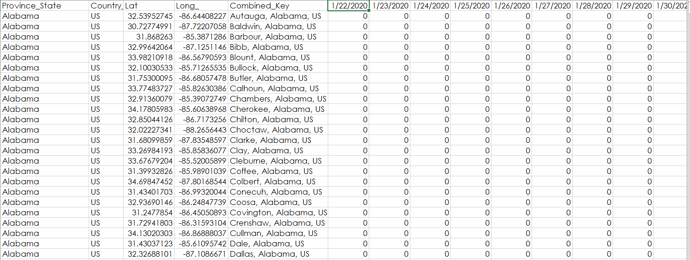
Sample Raw Data
COVID-19 Time Series US Data:
Notes:
victoria

Slide 7
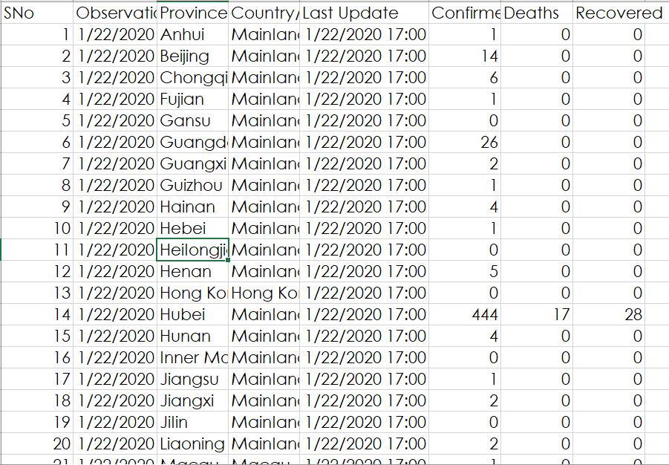
COVID-19 Daily & International Data:
Notes:
victoria

Slide 8

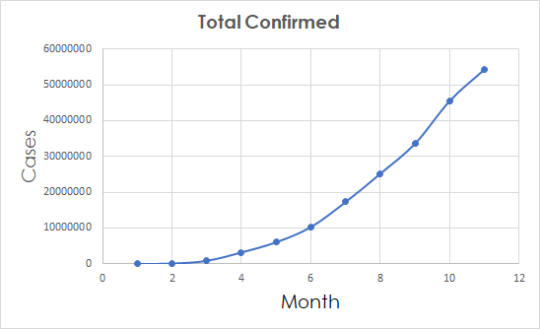
Month | Total Confirmed | Total Recovered | Total Deaths | Recovered - Deaths
1 | 10151 | 229 | 213 | 16
2 | 85484 | 39634 | 2942 | 36692
3 | 857487 | 178028 | 42107 | 135921
4 | 3193886 | 972719 | 227638 | 745081
5 | 6059031 | 2564693 | 369126 | 2195567
6 | 10302168 | 5235813 | 505505 | 4730308
7 | 17309823 | 10170650 | 673194 | 9497456
8 | 25223398 | 16618855 | 846423 | 15772432
9 | 33647197 | 23392396 | 1008060 | 22384336
10 | 45601023 | 29690219 | 1189088 | 28501131
11 | 54370186 | 34955148 | 1317139 | 33638009
Exploratory Data Analysis
This chart and table shows the cumulative exponential growth of COVID-19 in 2020.
These numbers encompass all international cases
Notes:
victoria

Slide 9
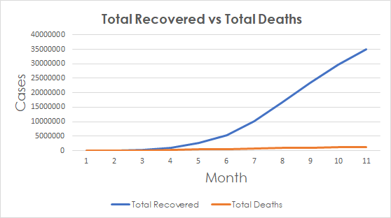
Exploratory Data Analysis
This graph shows total cases that
ended in Recovered or Death.
In the beginning, more cases
resulted in more deaths, but as
doctors learned how to combat the
symptoms, we started to see more
cases end with recovery starting in
April.
Now we see the recovered slope
closely follows the confirmed slope, confirming that many cases do end up in recovery.
The mortality rate (Total Deaths/ Total Confirmed) was at its high in April at 7% but in November it has dropped to 2.4%
Notes:
victoria

Slide 10
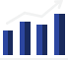
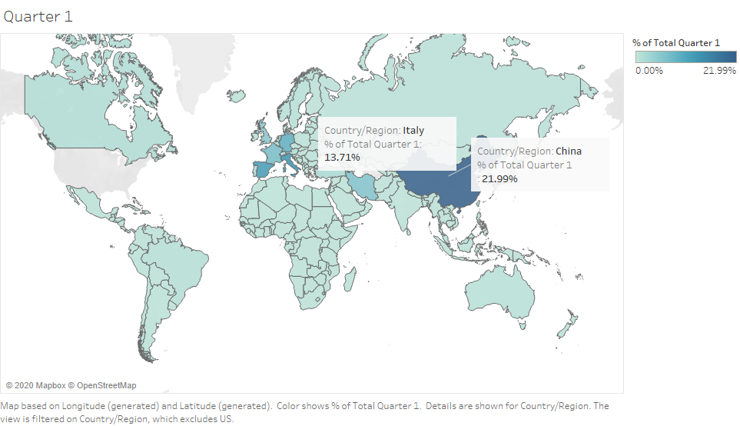
Data Visualization
For the Quarter 1 of 2020, China comprised the highest number of COVID-19 cases i.e., about 22%
of the total cases across the world were from China.
Also, Italy did not standAlso, Italy did not stand
Also, Italy did not stand far behind with 13.71% cases of the world being from Italy. Italy being a relatively small country in Europe had a huge number of per capita cases as opposed to China which is approximately 30 times the size of Italy!
Notes:
saloni

Slide 11
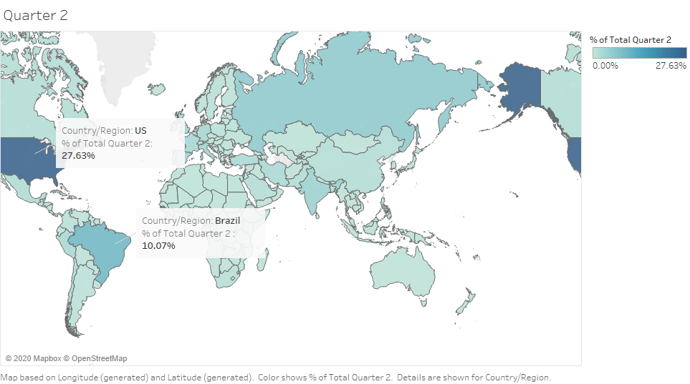
For Quarter 2, China no longer has maximum number of COVID cases.
Instead, US now has the highest share in terms of new COVID cases i.e., 27.63% of the cases worldwide to be precise. Southern America and in particular Brazil were also impacted by the virus during the second quarter having about 10% of total cases worldwide.
Notes:
salosasalonini

Slide 12
In Quarter 3, U.S. again led in terms of total COVID cases, but the total percentage of cases worldwide decreased to 23.08% from 27.63%.
Also, India had a boom in the number of cases in Quarter 3 and comprised 15.19% of the world’s share. Brazil was not far behind with 14.78% of the cases. We also observe that China and Italy which were major constituents in Quarter 1 have done fairly well in recovering from COVID-19.
Notes:
saloni

Slide 13
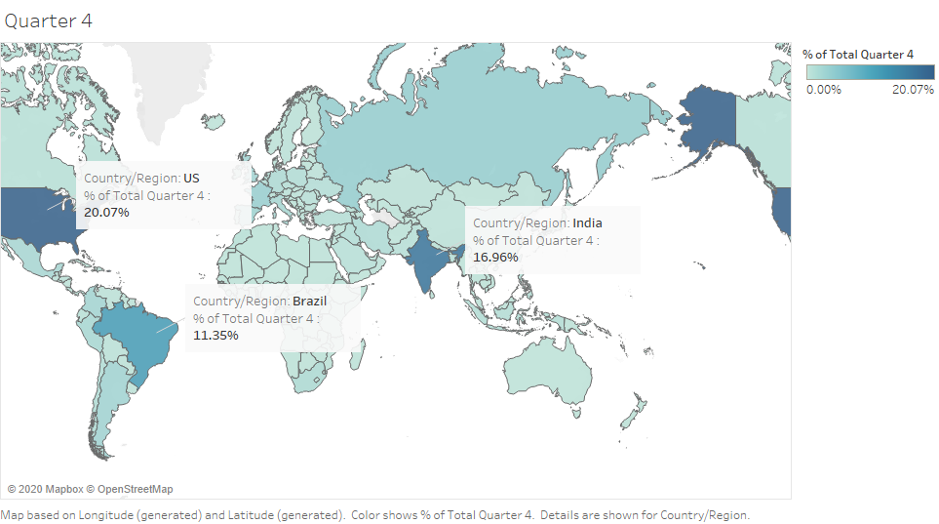
In Quarter 4, we observe a decrease in percentage share of COVID cases for U.S. and Brazil but the cases are still
but the cases are still rising and yet to reach their peak in India with India comprising approximately 17% cases alone worldwide.
Notes:
saloni

Slide 14
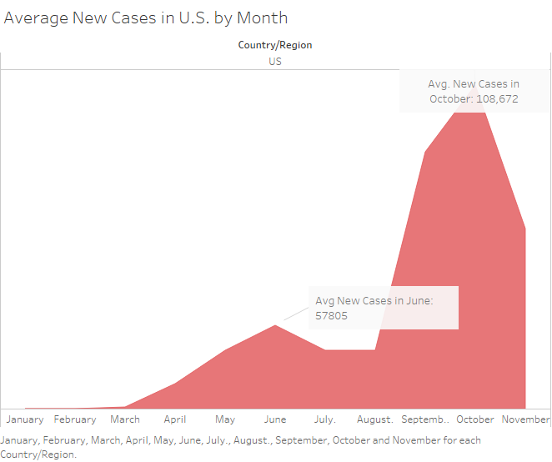
These are average number of new cases in United States across different months of 2020 where the first COVID-19 wave starts in March, the peak number of cases are in June with an average of 58000.
After a steep decline in the number of new cases across July and mostly in August, cases again shoot up and second COVID-19 wave with average new cases in October shooting up to 108,672 which is twice the number of peak cases during the first wave.
The number of cases declined in November as data was available till its 15th. The result for this month isn’t reflective to actual results.
Notes:
saloni

Slide 15
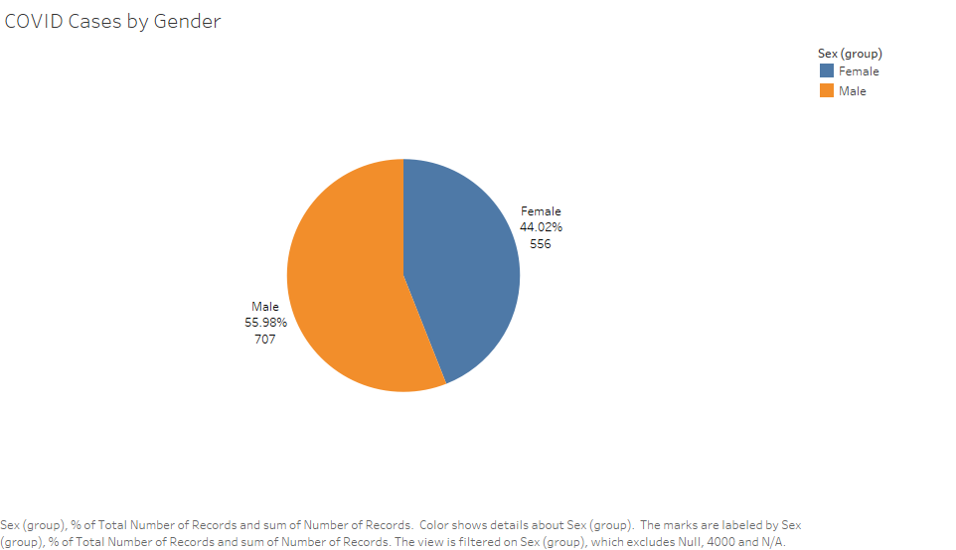
The pie chart shows the distribution of the total COVID-19 cases based on the gender. We observe that while both genders are almost equally likely to suffer from COVID, there is a slightly more possibility for being affected by COVID-19 for males with males comprising about 56% of the total COVID cases and females are slightly less likely to have the disease than the male counterparts.
Notes:
saloni

Slide 16
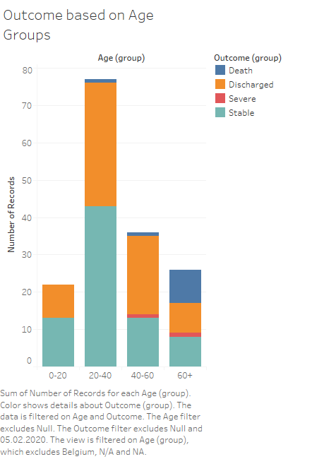
This is a stacked bar chart depicting the different outcomes or present conditions of the people who were/are affected by COVID-19.
We have also grouped the data based on the ages with 4 distinct age groups. We observe that the age groups 20-40 and 40-60 are the most sensitive ages to be infected with COVID-19.
These age groups contains people who are either stable or have been discharged showing a low mortality rate as compared to the age group 60+. This age group consisting of elderly people with low immunities has about one-third of the people infected in it who died after being infected, showing a high mortality rate.
Notes:
saloni

Slide 17

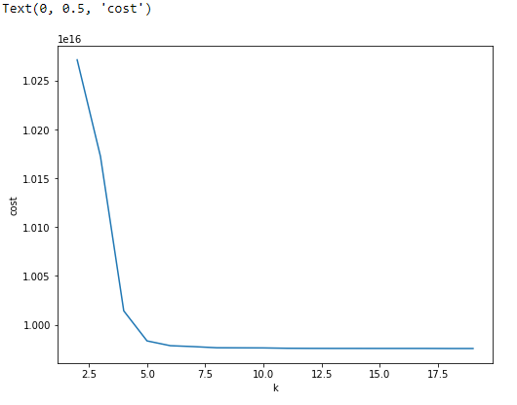
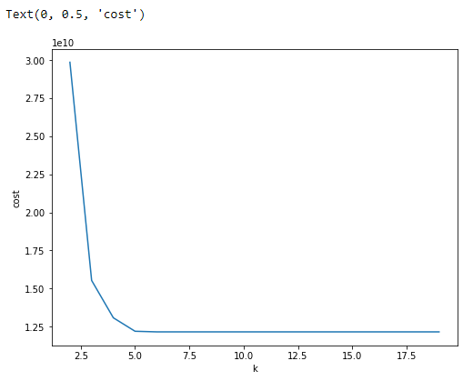
Model: K-Means Clustering Algorithm
The following elbow graphs for the World Dataset and the US dataset:
World Dataset USA Dataset
Notes:
bhakti

Slide 18
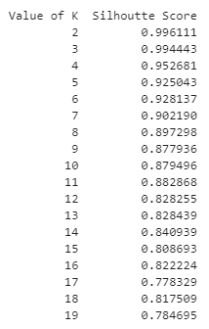
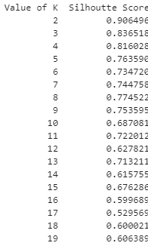
Silhouette Scores obtained for the World Dataset and the US dataset:
World Dataset USA Dataset
Notes:
bhakti

Slide 19
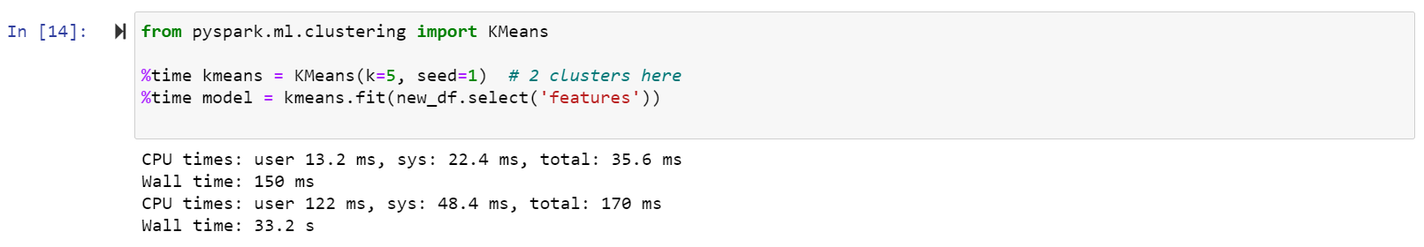
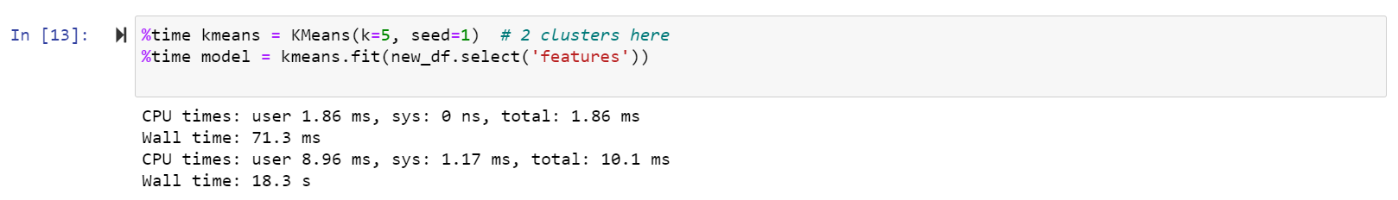
Impact of Scale Analysis
Based on time and parallel computation:
The first measurement of performance we tested was time performance (Based on simple execution of k-mean based on the chosen k values)
The first time we ran the model was on a Docker container in a Jupyter notebook in PySpark on a local Windows computer. This took 33 seconds
We switched to the AWS ec2 service, opting for a Linux virtual machine with a higher memory capacity. The model ran in 18.2 seconds.
Notes:
bhakti

Slide 20
Using a machine with higher memory, bandwidth, and CPU core improved the time performance of the model and had an overall increase in the quality of analysis.
For time and parallel computation, we checked the performance of Local Machine based Jupyter Notebook with AWS EMR running on clusters size of 3 (1 master and two nodes)
This comparison is based on the computation of the Silhouette scores for different values of k (2,20) on the two datasets
We tried to show the substantial difference in the speed based on a single machine and parallel machines
Time taken for computing Silhouette scores ( k in range (2,20) | Local Machine (sec) | AWS EMR (cluster of 3) (sec)
World Dataset | 723.32 | 55.96
USA Dataset | 702.48 | 27
Notes:
bhakti

Slide 21
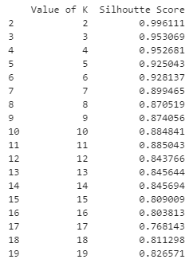
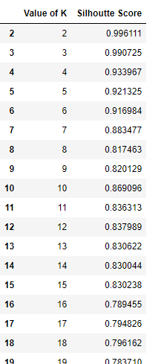
Based on quality of analysis:
Our major comparison metric over here was the value of the Silhouette scores. This score compares how well the elements of clusters are classified and we compare the performance for this on a local single machine with the scores given by AWS EMR notebook. Here is the comparison below for the World Dataset.
As seen above, the AWS EMR makes or forms clusters in a better way compared to when the code is run on a single machine. For k = 4 on which our cluster is based there is a difference of 2 percent in the silhouette score. Similar results are observed for the US dataset where the parallel computation of AWS EMR outperforms single machines.
AWS EMR Local Machine
Notes:
bhakti

Slide 22

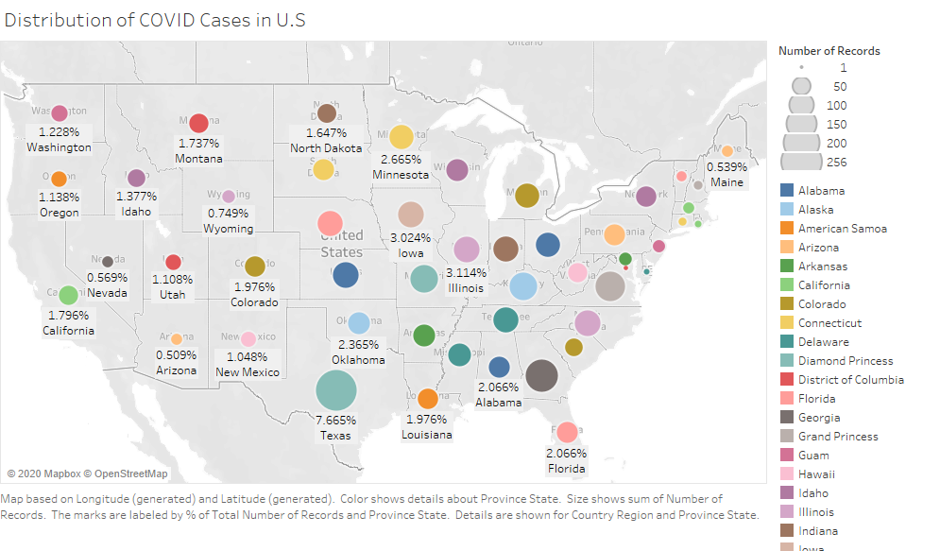
Key Results
This is distribution of COVID cases by states in the United States. The different sizes are based on the number of records in every state. Texas had the highest share of cases in the US in total for about 8% of total cases in the US were from Texas followed by Georgia and Virginia with about 4% cases individually. The least number of cases reported in Virgin Islands having a total share of 0.03% of total cases.
Notes:
ayushi

Slide 23
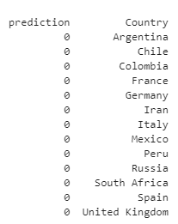
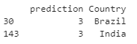
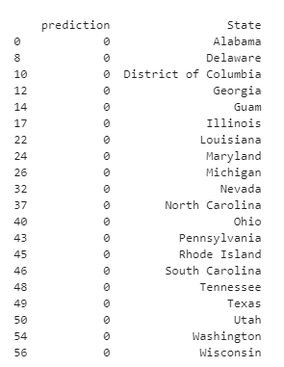
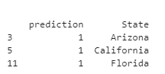
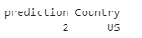
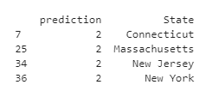
Key Results
From our analysis, we found several results that answer our key issues:
We found success with the geographical maps to best show the big dataset and how COVID-19 affected different regions over time
Through the exploratory analysis, we also found that the confirmed cases are rising faster than before, with October being the highest rise in cases.
In our model, we found four main clusters for the world dataset and for the US dataset:
World Clusters:
US Clusters:
Notes:
ayushi

Slide 24

Conclusion
Ultimately, COVID-19 is a pandemic that is causing an international crisis today. From this analysis, we have formed several conclusions:
The exploratory analysis showed a higher increase rate of confirmed cases and a decrease in deaths, which shows that many people are still spreading the virus without concern.
The COVID-19 cases can overflow hospital systems, cause unnecessary deaths to other illnesses or injuries that could have been treated with otherwise available resources. The pandemic is far from over and precautions need to be taken as soon as possible.
Notes:
Ayushi

Slide 25
The clustering model showed the USA being the country with highest cases is associated with a single cluster. The next affected countries Brazil and India are associated with another cluster. For the state level, the tristate area has been clustered together, again indicating a geographical significance. The states with the highest cases California and Florida belong to another cluster. This information is significant to determine where higher amounts of vaccines and medications will be needed and which areas require assistance with dealing with an outbreak.
Geographical maps made it much less complex to analyze the big dataset, rather than sifting through the locations column on an Excel document. This map showed which countries were successful in combating the virus, such as China, and which are still struggling today, like the USA.
Notes:
Ayushi Ayushi
Aayushi

Slide 26
Future Recommendations
The John Hopkins dataset is updated almost everyday as new numbers come from the WHO and CDC, so it would be interesting to keep running the analysis and model with new dataset to see what changes has happened. There are a few recommendations for further analysis:
Add on dynamic data stories with more automated and consumerized experiences in our analysis
Add graph analytics to assist us in identifying, predicting and planning for upcoming covid disaster in the future. When combined with ML algorithms, graph analytics technologies can be used to discover new possible treatments or factors that contribute to more negative outcomes for some infected people, as well as uncover hidden patterns and relationships
Add augmented data management. This makes use of ML and AI techniques to optimize and improve operations, converts metadata from being used in auditing, lineage and reporting to powering dynamic systems, examines large samples of operational data, including actual queries, performance data and schemas
Notes:
ayushi

Slide 27


COVID-19 global numbers:
https://tinyurl.com/y6lcjnng
Johns Hopkins Dashboard:
https://www.arcgis.com/apps/opsdashboard/index.html#/bda7594740fd40299423467b48e9ecf6
Dataset:
https://www.kaggle.com/sudalairajkumar/novel-corona-virus-2019-dataset
4. Project Code:
https://drive.google.com/drive/folders/18ok4OWUCtvq6q68BX9Sw9a7GOyhrNTeA?usp=sharing
Notes:
ayushi

